Slide 1
Quality Management
Dr. Narpat Ram Sangwa
Assistant Professor
Operations & Supply Chain Management
IIM Sirmaur

Slide 2
Learnings
What is quality?
What are the dimensions of product quality and service quality?
How does quality management evolve over the period of time?
What is cost of quality?
What are the major categories of quality cost?
How to measure and report quality cost?

Slide 3
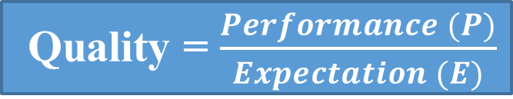
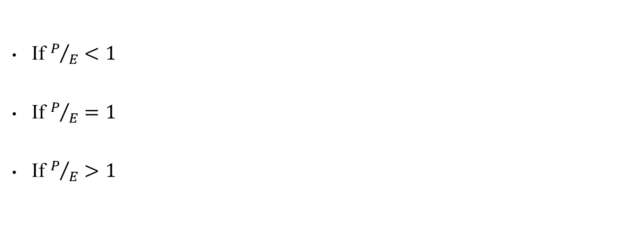
Quality
Dr. Joseph M. Juran defind quality as:
“Fitness for Use”
It is the ability of a product or service to consistently meet or exceed customer requirements or expectations.
If $P/E<1$
If $P/E=1$
If $P/E>1$
Quality = $\frac{Performance (P)}{Expectation (E)}$
Customer Dissatisfaction
Customer Attrition
Not sure that customer
will return/ repeat the order
Customer Satisfaction
Customer will return/ repeat the order
Customer Delight

Slide 4
Quality
The American Society of Quality (ASQ) defined quality as:
“The totality of features and characteristics of a product or service that bear on its ability to satisfy stated or implied needs.”
Example: A company manufactures a type of pneumatic valve. The valve can bear maximum resistance pressure of 150 MPa as mentioned in the specification.
Implied need: The valve should be 100% seal or leak proof.

Slide 5
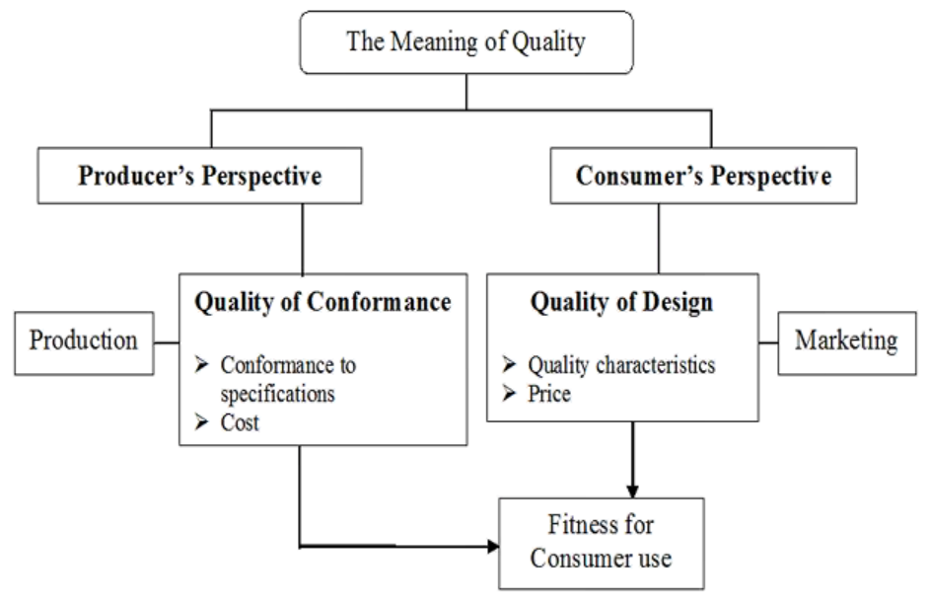
Perspectives on Quality
The degree to which goods or services conform to the intent of the designers.
Intention of designers to include or exclude features in a product or service.

Slide 6
Dimensions of Product Quality
Product Quality
Performance
Aesthetics
Perceived quality
Conformance
Features
Reliability
Serviceability
Durability

Slide 7
Dimensions of Product Quality
Garvin (1987) provided eight dimensions of product quality:
Performance: How efficient the product is in achieving its intended purpose?
Reliability: How does the product perform consistently within an expected time frame?
Durability: How long the product works before replacement?
Serviceability: How easy to repair the product?
Features: Is extra facility added to the basic features?
Aesthetics: How does the product look or feel?
Perceived quality: What is the reputation of the product?
Conformance: Is the product made exactly as the designer intended?

Slide 8
Dimensions of Service Quality
Service Quality
Reliability
Responsiveness
Assurance
Empathy
Tangible

Slide 9
Dimensions of Service Quality
Parasuraman et al., (1988) provided five service dimensions in their SERVEQUAL model which can be used as criteria to judge service quality.
Although these dimensions are not mutually exclusive, but provide a framework to understand what customers expect from a service provider.
Reliability: The ability to perform the promised service consistently and accurately.
Ex: A proper query reply via email should be sent to the customer within a specified time period.
Responsiveness: The willingness to help customers and provide prompt service.
Ex: Avoid keeping the customer waiting for no apparent reason.

Slide 10
Dimensions of Service Quality
Assurance: The knowledge and competence of employees and their ability to convey trust, believability, and confidence.
Ex: Being polite and showing respect to customers providing correct and useful information.
Empathy: The caring and individualized attention provided to customers.
Ex: Being a good listener, recognizing the regular customer.
Tangible: The physical characteristics of a service such as appearance of physical facilities, equipment, and the appearance of personnel.
Ex: Cleanliness

Slide 11

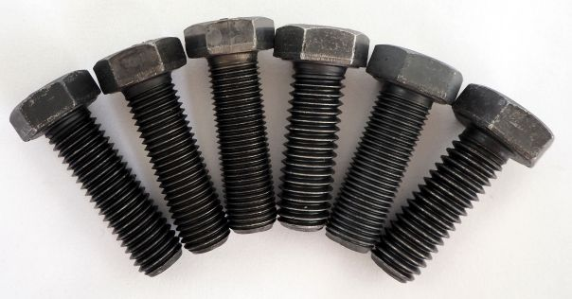
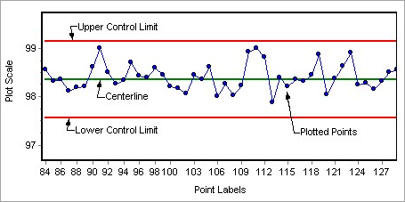
Quality Management
Systematic policies, methods, and procedures
Used to ensure that goods and services are produced with appropriate quality level to meet customers’ needs.
Deals with issues relating to how goods and services are designed, created, and delivered to meet customer expectations
Historical uses of quality management include:
The precision involved in the building of Egyptian pyramids.
Interchangeable parts during second industrial revolution.
Statistical tools used for quality control during World War II.

Slide 12
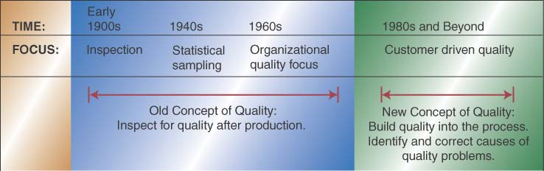
Evolution of Quality management

Slide 13
Evolution of Quality Management
Normal Curve
Control Chart
Probability analysis & Hypothesis Testing
Pareto Diagram
FMEA
Set Rules for Brainstorming
Cause and Effect Diagram
Kano Model
Six Sigma
Source: Slideshare.net

Slide 14
Quality Guru’s Contribution
Contributor | Key Contributions
Shewhart | Control charts; variance reduction.
Deming | 14 points; special versus common causes of variation.
Juran | Quality is fitness-for-use; quality trilogy.
Feigenbaum | Quality is a total field; the customer defines quality.
Crosby | Quality is free; zero defects.
Ishikawa | Cause-and-effect diagrams; quality circles.
Taguchi | Taguchi loss function.
Ohno and Shingo | Continuous improvement.

Slide 15
Cost of Quality
Cost of Quality (COQ): The cost of avoiding poor quality, or costs incurred as a result of poor quality.
COQ is usually the sum of conformance plus non-conformance costs.
Cost of conformance is the price paid for the prevention from poor quality.
Cost of non-conformance is the cost of poor quality caused by product or service failure.
COQ translates quality problems into the “language” of top management—the language of money,
And helps operations managers:
To communicate in a better way to senior-level managers
To identify and justify major improvement opportunities
To evaluate the importance of quality and improvement in operations
Notes:
Poor quality impacts companies in two ways: Higher cost and lower customer satisfactions. The lower customer satisfaction creates price pressure and lost sales, which results in lower revenue sometimes makes a company go out of business.

Slide 16
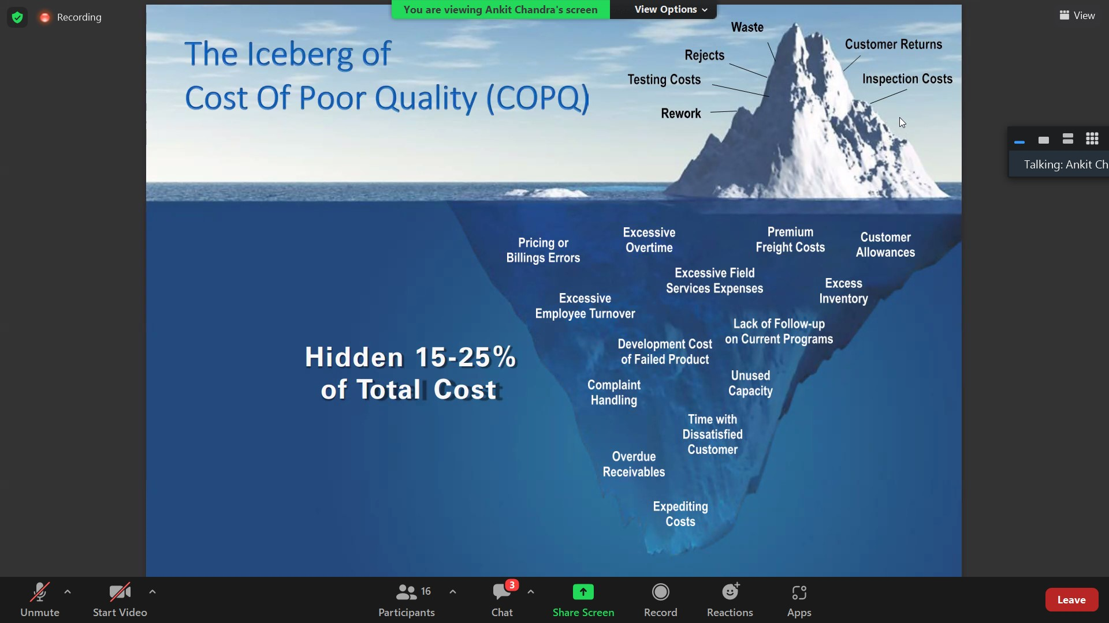
Cost of Quality
Source: http://sureshlulla.com

Slide 17
Cost of Quality
Poor quality impacts companies in two ways: higher cost, and lower customer satisfactions.
There are visible as well as hidden components of cost of quality. The visible components of cost of quality includes:
Rework during manufacturing
Retesting of an assembly
Scrapping a product
Repurchasing parts
Warranty claims, etc.
Hidden components of cost of quality includes:
Time spent to identify failure
Remedial actions to failure
Loss of order due to poor quality
Responding to customer complaints, etc.
Notes:
The lower customer satisfaction creates price pressure and lost sales, which results in lower revenue sometimes makes a company go out of business.

Slide 18
Major Categories of Quality Costs
The American Society for Quality control, in 1971, had defined four major categories of quality costs:
Prevention costs
Appraisal costs
Internal failure costs
External failure costs
Total quality costs is the sum of the above four costs.
or
The total quality cost will represent the difference between the actual cost of a product and the reduced cost if there is a possibility of neither failure nor any defects in the products.

Slide 19
Major Categories of Quality Costs
Prevention: Investments made to keep nonconforming goods and services from being made and reaching the customer.
Quality planning costs
Process-control costs
Process capability evaluation,
Quality data acquisition and analysis
Training and general quality management costs
Appraisal: Associated with efforts to ensure conformance to requirements, generally through measurement and analysis of data to detect nonconformance.
Testing and inspection costs of incoming materials
Semi-finished or finished product testing and inspection costs
Cost of material or product consumed during the destructive test
Instrument maintenance costs
Calibration cost of measuring instruments

Slide 20
Major Categories of Quality Costs
Internal failure: Incurred as a result of unsatisfactory quality that is found before the delivery of a good or service
Scrap, rework, and retest costs
Costs of corrective action
Process failures
Yield losses due to process variation
Downgrading costs
External failure: Incurred after poor-quality goods or services reach the customer
Costs due to customer complaints and returns
Goods and services recall costs
Warranty and service guarantee claims
Lost sales (loss of good will, market share)

Slide 21
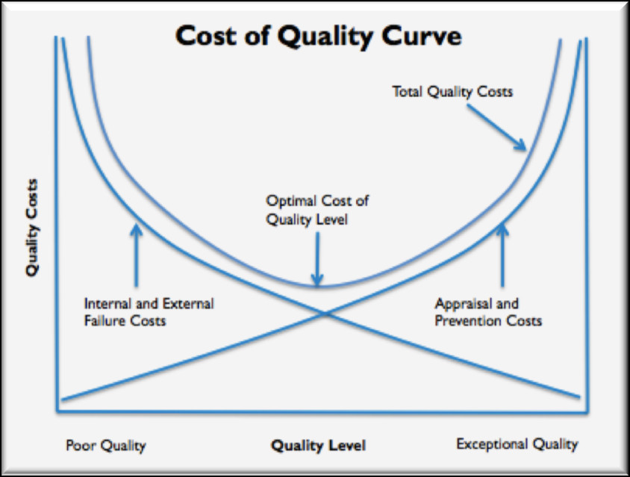
Cost of Quality Curve

Slide 22
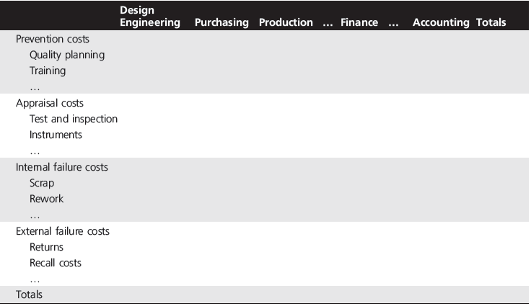
Cost of Quality Reporting Matrix

Slide 23
Quality Control Tools
The Basic Seven Quality Control Tools made statistical analysis less complicated for the average person
Good Visual Aids make statistical and quality control more comprehendible.
Provides a more structured path for problem-solving and quality improvement.
Easy to understand and implement.
A scientific and logical approach for problem-solving.

Slide 24
Process Flowchart
The process flowchart is a method of describing sequence of activities of the process. It depicts the flow of material and/or information.
It has the following advantages:
Helps to understand a process by explaining the sequence of steps.
Flowchart can be very useful in training employees according to standardized procedures.
Identify problem areas and opportunities for process improvement.

Slide 25
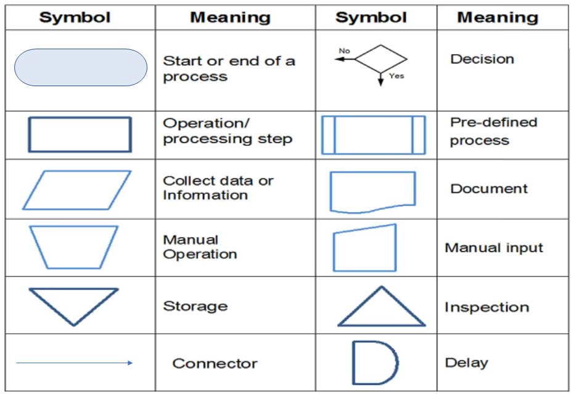
Process Flowchart
Symbols

Slide 26
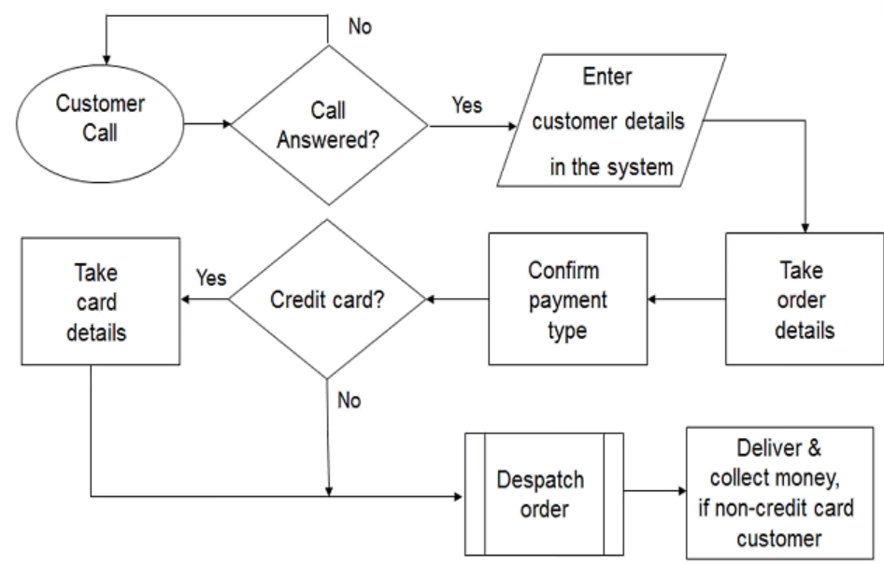
Process Flowchart
Ex: Pizza Home Delivery Process

Slide 27
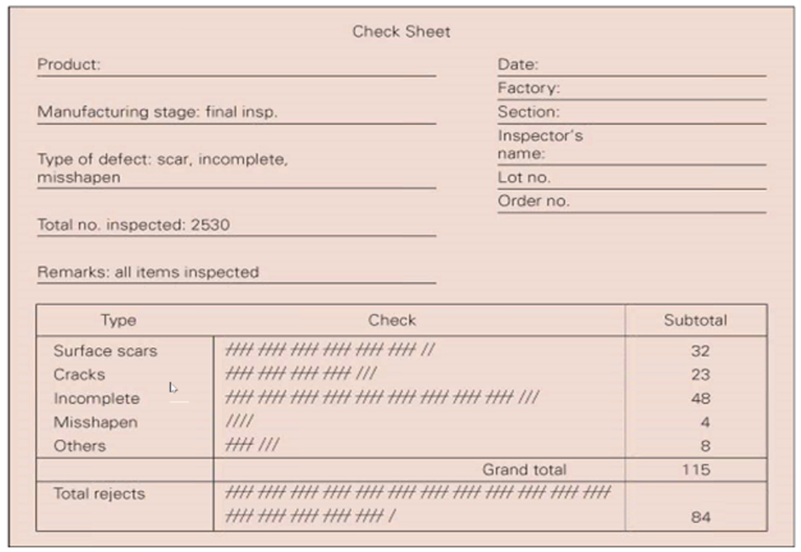
Check Sheets
The check sheet is a form (document) used to collect data in real time at the location where the data is generated.
To prepare the check sheets:
Decide on the exact event to be observed.
Decide on the duration of observation.
Design the form in an easy to understand manner.
Make sure that the observations are as random as possible.
Make sure that accuracy is maintained.
Figure: Final Stage Inspection

Slide 28
Check Sheets
Kaoru Ishikawa identified five uses for check sheets in quality control:
To check the shape of the probability distribution of a process
To quantify defects by type
To quantify defects by location
To quantify defects by cause
To keep track of the completion of
steps in a multistep procedure
(in other words, as a checklist)
Problem | Time (Period)
 | 6 am | 10 am | 2 pm | 6 pm | 10 pm | Total
A | III | II | III | IIII | II | 15
B | I | III | IIII | III | II | 14
C | I | I | III | II | I | 8
D | III | I | II | I | IIII | 11
E | II | IIII | III | IIII | IIII | 19
Total | 10 | 12 | 16 | 16 | 13 | 67

Slide 29
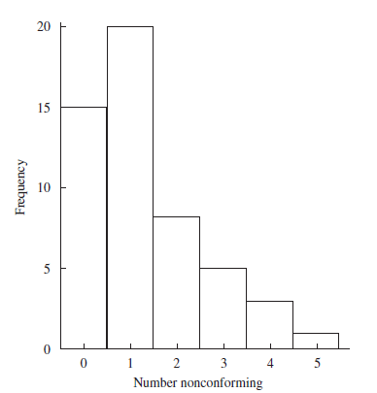
Histogram

Slide 30
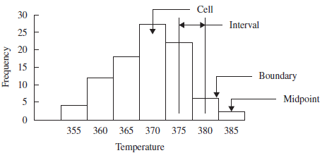
Histogram
In general, the number of cells should be between 5 and 20. Broad guidelines are as follows:
Use 5 to 9 cells when the number of observations is less than 100;
Use 8 to 17 cells when the number of observations is between 100 and 500; and
Use 15 to 20 cells when the number of observations is greater than 500.

Slide 31
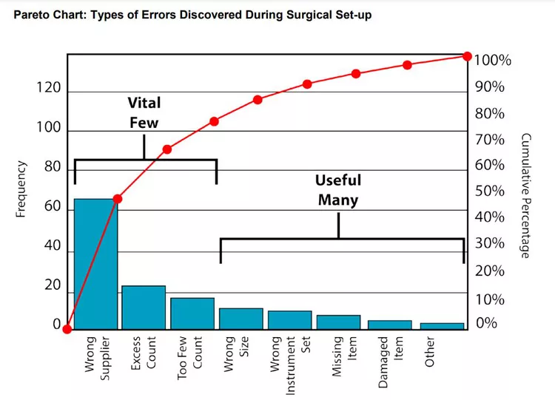
Pareto Chart

Slide 32
Pareto Chart
Examples of the vital few are:
A few customers account for the majority of sales.
A few processes account for the bulk of the scrap or rework cost.
A few nonconformities account for the majority of customer complaints.
A few suppliers account for the majority of rejected parts.
A few problems account for the bulk of the process downtime.
A few products account for the majority of the profit.
A few items account for the bulk of the inventory cost.

Slide 33
Pareto Chart
Construction of a Pareto diagram is very simple. There are five steps:
1. Determine the method of classifying the data: by problem, cause, nonconformity, and so forth.
2. Decide if dollars (best), frequency, or both are to be used to rank the characteristics.
3. Collect data for an appropriate time interval or use historical data.
4. Summarize the data and rank order categories from largest to smallest.
5. Construct the diagram and find the vital few.

Slide 34
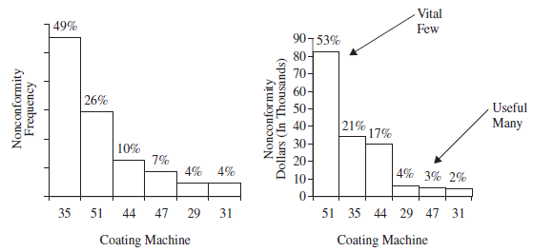
Pareto Chart

Slide 35
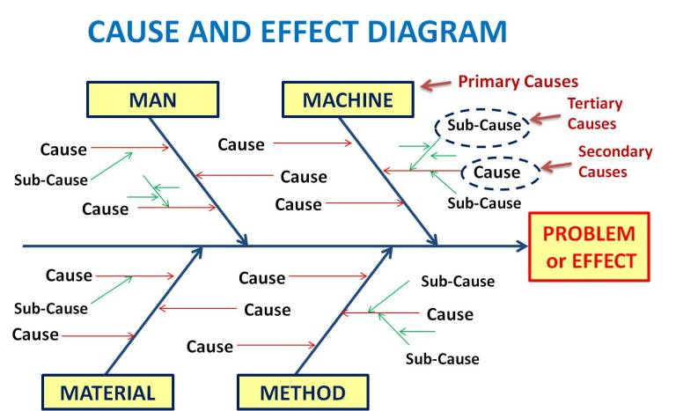
Cause and Effect Diagram

Slide 36
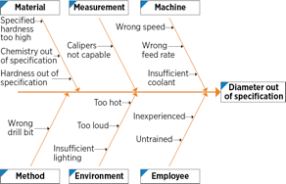
Cause and Effect Diagram

Slide 37
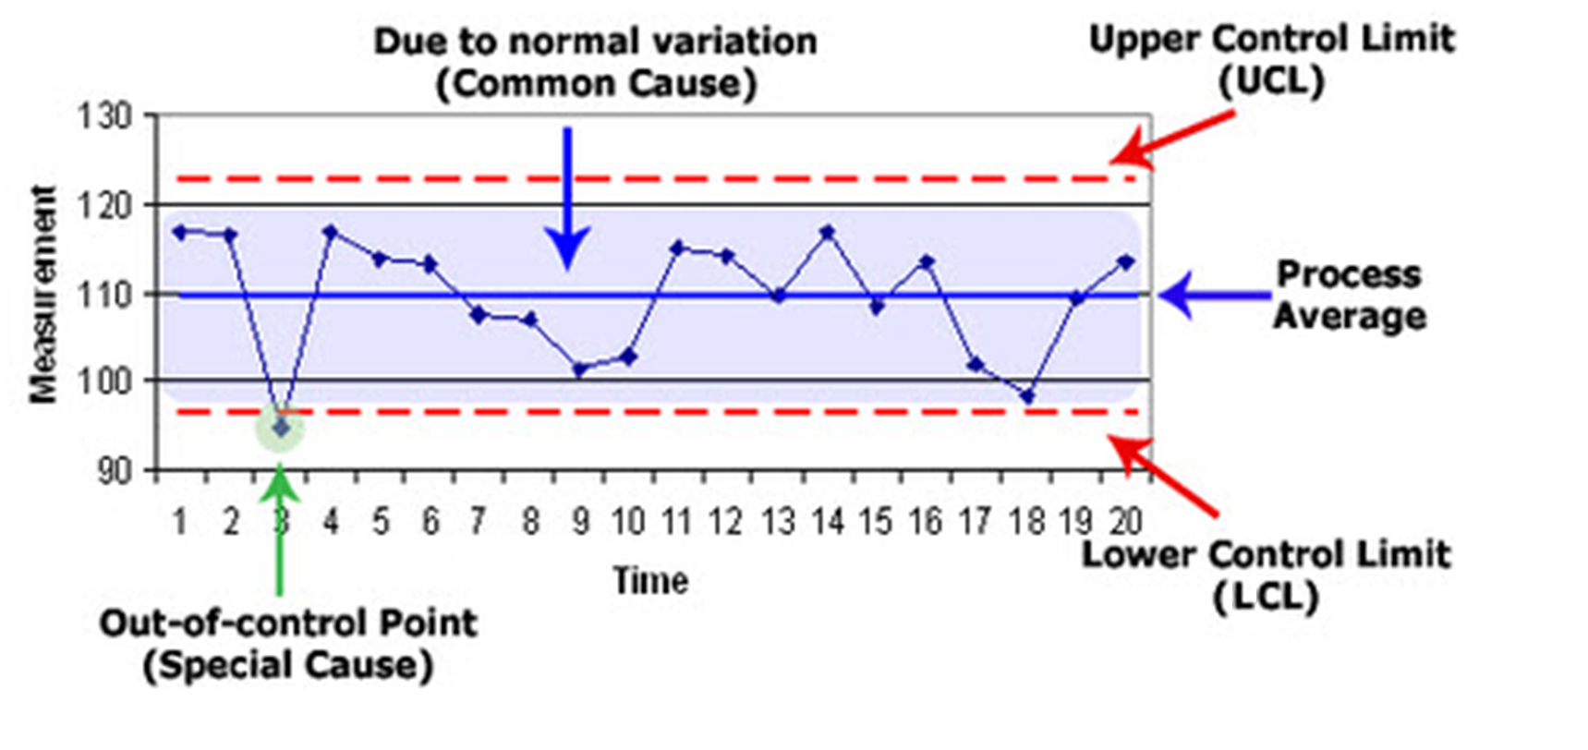
Control Charts

Slide 38
Scatter Diagram
A scatter diagram is a graphical presentation of the co-relationship between two types of process variables.
When two variables show a relationship on a scatter diagram, they are said to be correlated.
The correlation coefficient, r, is a statistical measure of the strength and direction of the linear relationship between two variables.
r is always between -1 and 1.
r is also known as Pearson’s correlation coefficient.
When r is close to zero, no linear relationship is present.
When a relationship exists, the variables are said to be correlated.
Perfect negative relationship: r = –1.0
No linear correlation: r = 0
Perfect positive relationship: r = +1.0

Slide 39
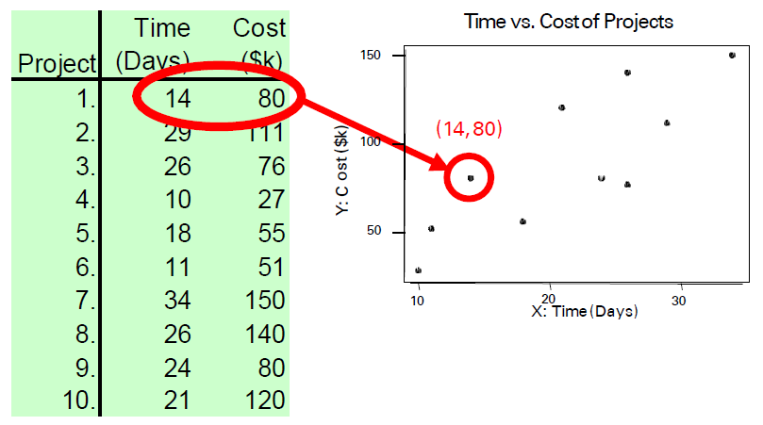
Scatter Diagram
Source: KPMG

Slide 40
What is Quality Control?
Quality control:
A process that evaluates output relative to a standard and takes corrective action when output doesn’t meet standards.
If results are acceptable no further action is required.
Unacceptable results call for correction action.
Inspection alone is not sufficient to achieve a reasonable level of quality.
Most organizations rely upon some inspection and a great deal of process control to achieve an acceptable level of quality.

Slide 41
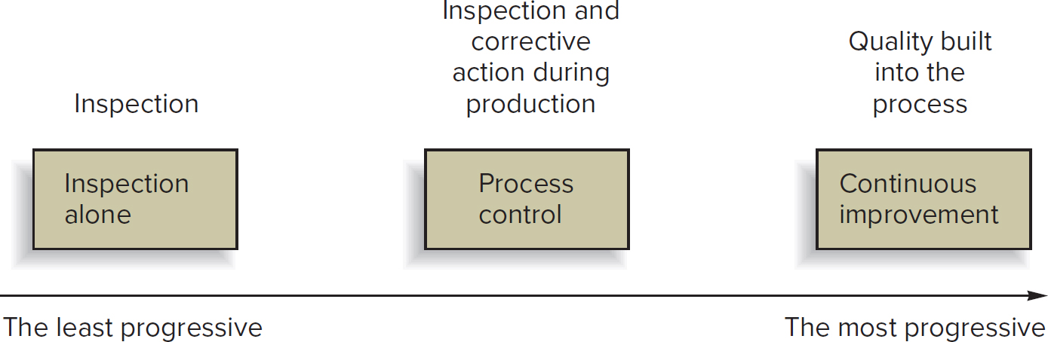
Approaches to Quality Assurance

Slide 42
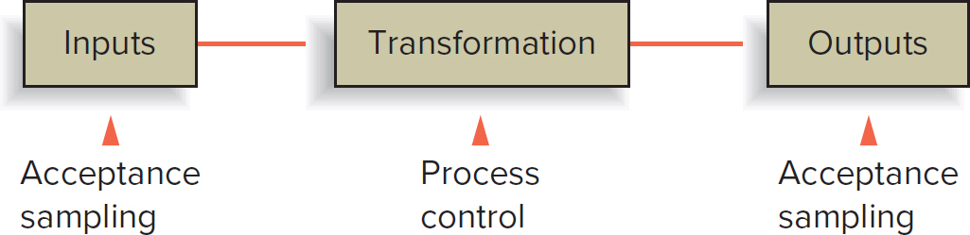
Acceptance Sampling and Process Control
Inspection before and after production often involves acceptance sampling procedures.
Monitoring during production process called process control.

Slide 43
Exercise for Inspection
Let’s Count!
F
Instruction
Read the passage given in next slide, individually and considering that every occurrence of the alphabet “f” is a defect, report out the number of f’s mentioned in the passage.
Time given is 2 Minutes.

Slide 44
Count Letter “F”
The necessity of training farm hands for first class farms in the fatherly handling of farm livestock is foremost in the minds of effective farm owners. Since the forefathers of the farm owners trained the farm hands for first class farms in the fatherly handling of farm livestock, the farm owners feel they should carry on with the former family tradition of training farmhands of first class farms in the effective fatherly handling of farm livestock, however futile, because of their belief that it forms the basis of effective farm management efforts.
Correct Answer
48
Inferences:
All the defects are not identified.
Different inspectors will identify different number/ types of defect.

Slide 45
Inspection
Inspection:
An appraisal activity that compares goods or services to a standard.
Inspection issues:
How much to inspect and how often.
At what points in the process inspection should occur.
Whether to inspect in a centralized or on-site location.
Whether data results from inspecting attributes or variables.

Slide 46
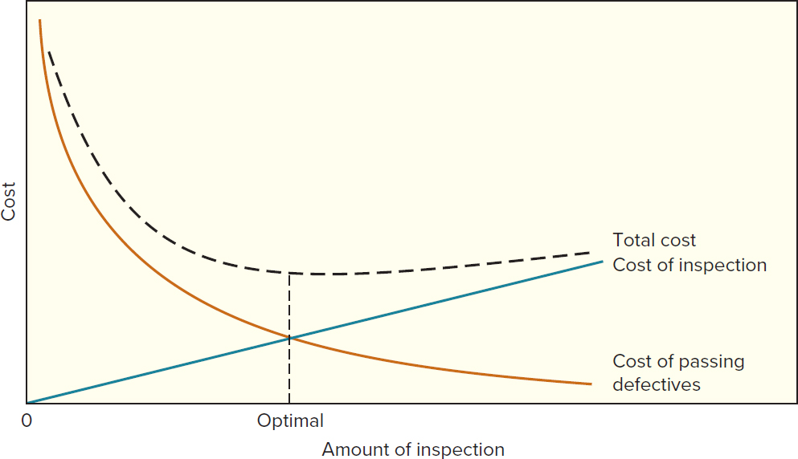
How Much to Inspect

Slide 47
How Often to Inspect
Frequency of inspection depends on the rate at which:
A process may go out of control.
On number of lots being inspected.
A stable process will require only infrequent checks.
Many small lots will require more samples than a few large lots.

Slide 48
Where to Inspect in the Process
Typical inspection points:
Raw materials and purchased parts.
Finished products.
Before a costly operation.
Before an irreversible process.
Before a covering process.

Slide 49
Example of Inspection at a Hotel/Motel
Inspection Point | Characteristics
Accounting/billing | Accuracy, timeliness
Building and grounds | Appearance and safety
Main desk | Appearance, waiting times, accuracy of bills
Maid service | Completeness, productivity
Personnel | Appearance, manners, productivity
Reservations/occupancy | Over/underbooking, percent occupancy
Restaurants | Kitchen, menus, meals, bills
Room service | Waiting time, quality of food
Supplies | Ordering, receiving, inventories

Slide 50
Off-Site versus On-Site Inspection
Effects on cost and level of disruption are a major issue in selecting centralized versus on-site inspection.
Off-Site:
Specialized tests that may best be completed in a lab.
More specialized testing equipment.
More favorable testing environment.
On-Site:
Quicker decisions are rendered.
Avoidance of introduction of extraneous factors.
Quality at the source.

Slide 51
Process Variability
All processes generate output that exhibits some degree of variability.
Two basic questions concerning variability:
Issue of process control.
Are the variations random? If nonrandom variation is present, the process is considered to be unstable.
Issue of process capability.
Given a stable process, is the inherent variability of the process within a range that conforms to performance criteria?

Slide 52
Variation
Two kinds of variability:
Chance or random variations (common cause):
Natural variations in the output of a process, created by countless minor factors.
Assignable (special cause) variation:
A variation whose cause can be identified.
A nonrandom variation.

Slide 53
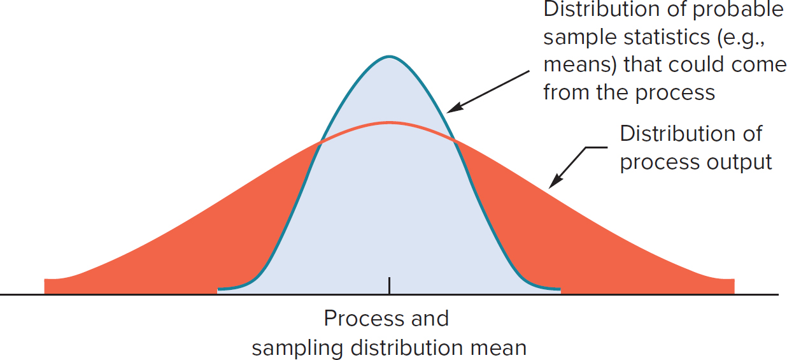
Sampling and Sampling Distribution
The sampling distribution of means is normal, and it has less variability than the process distribution, which might not be normal.

Slide 54
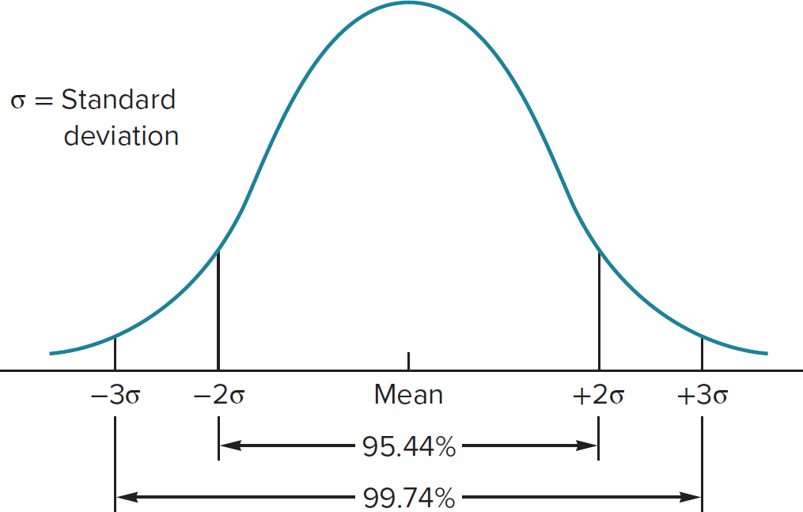
Sampling and Sampling Distribution
Percentage of values within given ranges in a normal distribution.

Slide 55
Control Charts: The Voice of the Process
Control chart:
A time-ordered plot of sample statistics obtained from an ongoing process (for example, sample means), used to determine if the variability exhibited reflects random variation.
Control limits:
The dividing lines between random and nonrandom deviations from the mean of the distribution.
Upper and lower control limits define the range of acceptable variation.

Slide 56
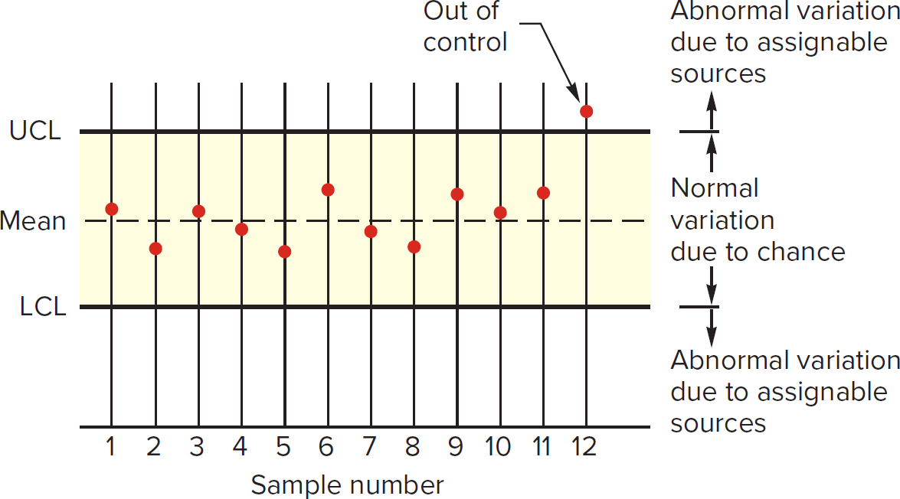
Control Chart and Control Limits
Each point on the control chart represents a sample of n observations.

Slide 57
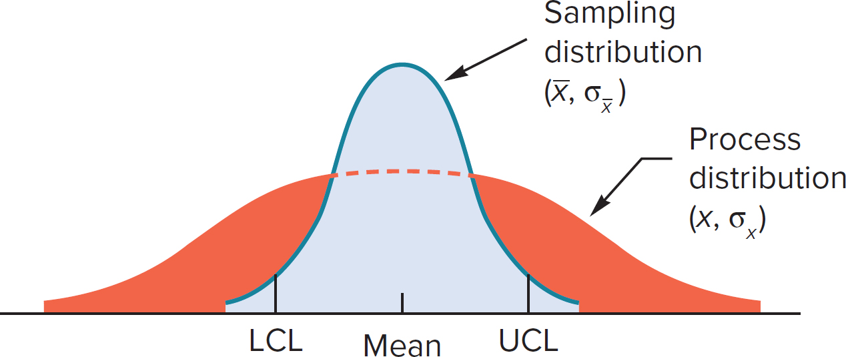
Control Limits
Control limits are based on the sampling distribution.

Slide 58
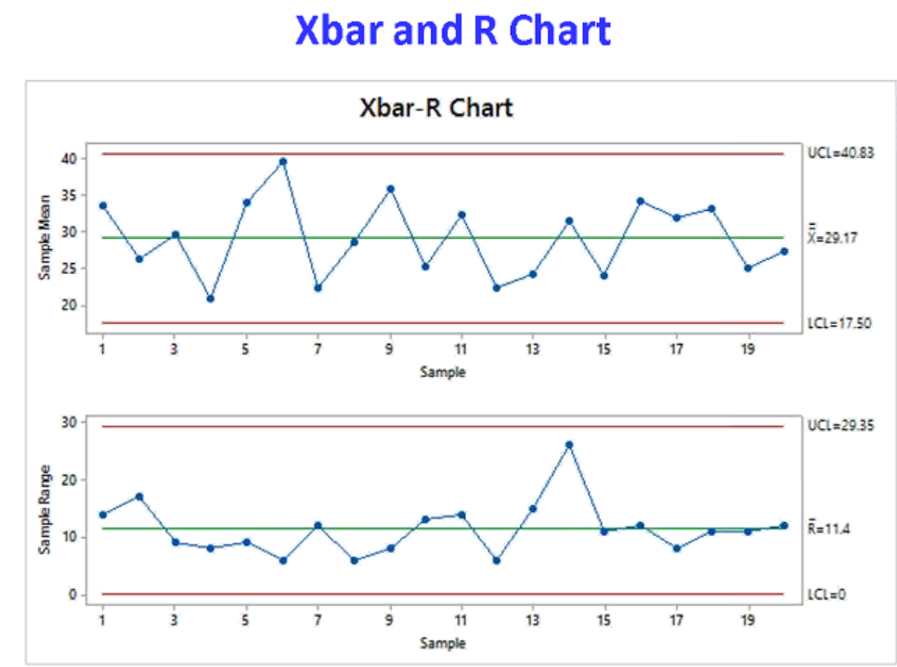
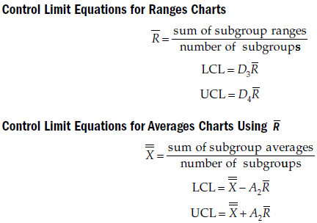
Control Limits

Slide 59
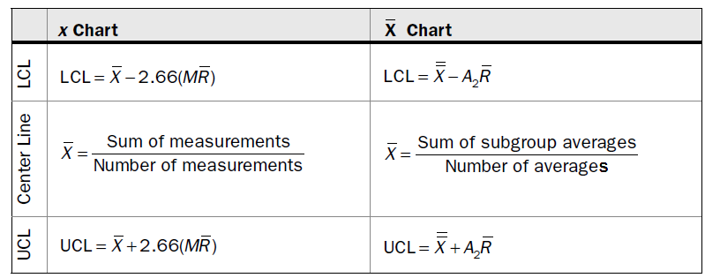
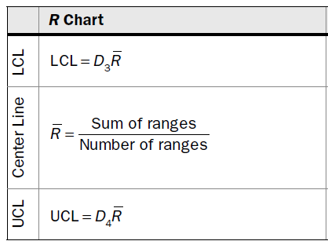
Control Limits

Slide 60
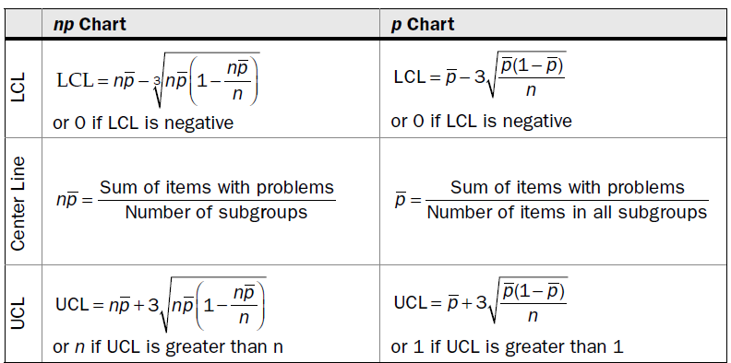
Control Limits

Slide 61
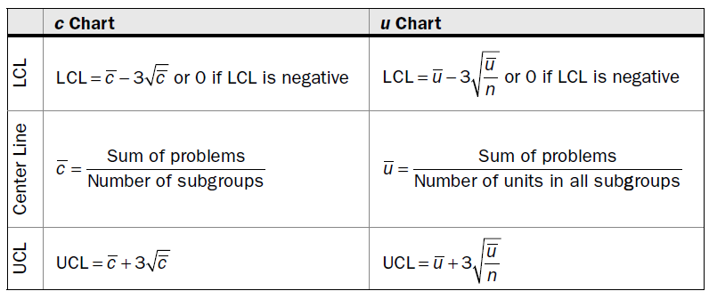
Control Limits

Slide 62
Factors for Three Sigma Control Charts
Table 10.3: Factors for three-sigma control limits for
and
R charts.

Slide 63
Factors for Three Sigma Control Charts
Source: Adapted from Eugene Grant and Richard Leavenworth, Statistical Quality Control, 5th ed. 19 80. McGraw-Hill Education.

Slide 64

Selecting Control Charts
Type of Data
VARIABLE / CONTINUOUS
DISCRETE / ATTRIBUTE
Individual Measurements or Subgroups?
Individual Subgroups
Defects or Defectives?
Defectives
Defects
I – MR Chart
Subgroup < 8
Yes No
Constant Sample Size?
Yes No
Constant Sample Size?
Yes No
X – Bar R chart
X - Bar S chart
np- chart
P-
chart
C-
chart
U-
chart
Notes:
Poisson distribution
Used to predict the variation from an average rate of occurrence in a given time frame. It's used when independent events occur in a fixed interval of time and have a known constant mean rate. The Poisson distribution is used to describe the distribution of binary data from an infinite sample.
Binomial distribution
Used to model the probability of obtaining one of two outcomes under a given number of parameters. It's used to describe the distribution of binary data from a finite sample

Slide 65


Thank You

